Slide 1
Pick N Place Final Presentation
Chris Suchezky

Slide 2
Objective
To design and build an autonomous robotic arm with the goal of finding and picking up shapes in order to sort them.

Slide 3
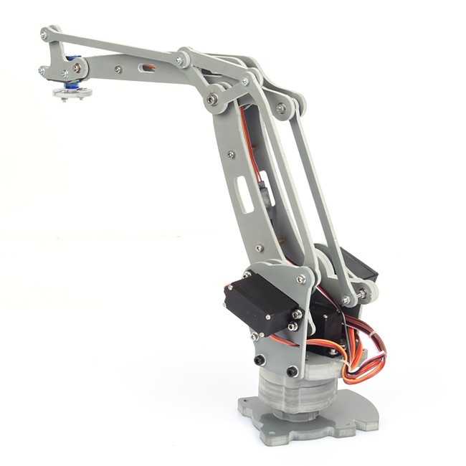
Research and first thoughts
3D Print vs Laser Cut
Elevator Motors
Design Review

Slide 4
Design Approach
Simple Design with all Servos on axis of rotation
Too much stress of servos, not enough torque
Elevator Motors
Implemented in design, most reliable joint
Pulley System
Implemented, semi-works, could be improved upon with better quality parts

Slide 5
Budget
Servos
Highest cost of the system
Chose high quality to avoid torque problems
Material - Wood
Cheap
Light
Strong
Easy to fabricate

Slide 6
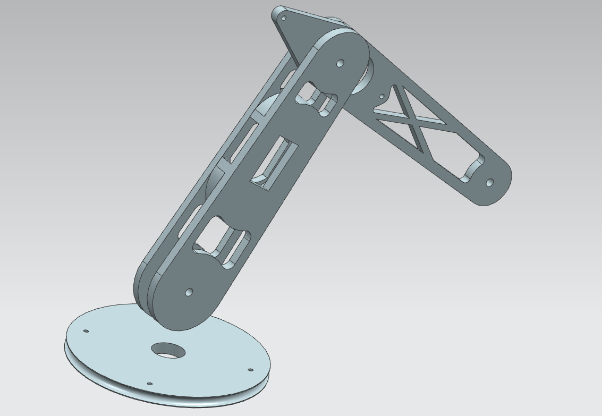
Design
Converting NX model to AutoCAD was easy
Laser cut material easy and structure designs were possible

Slide 7
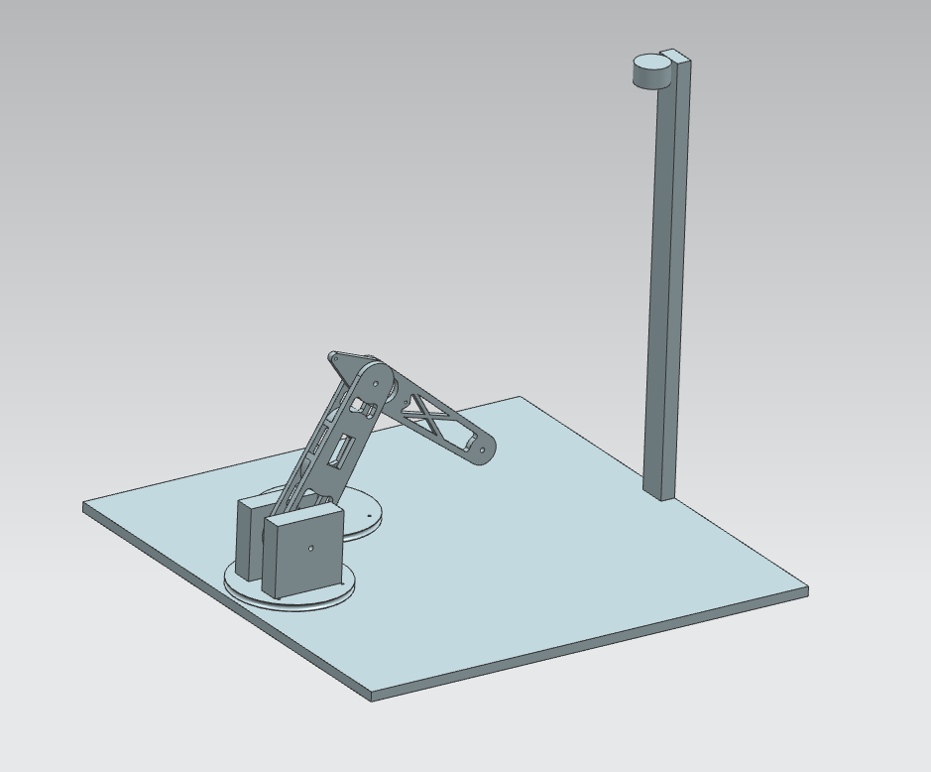
The layout was great
Camera out of the way of arm
Paper secured so no change in distances

Slide 8
Calculations
Law of Cosines
C^2 = a^2 + b^2 + 2ab*cos(C)
Used to calculate both Arm 1 and Arm 2
Pythagorean Theorem
A^2 + B^2 = C^2
Used to calculate distance from base
C
a
b
B
A
c

Slide 9
Programming
Find shape
Calculate angles
Send position to Arduino
Arduino moves motors and returns signal
Send left or right
Arduino sends shape and returns done
Find next shape

Slide 10
Budget
Servos 3 x $30.00
Material $40.00
Wood $25.00
Misc. $15.00
Electrical Components $20.00
Total ~$120.00

Slide 11
Test Results – lessons learned
Many trial runs
Turntable trial/error
Spring helping torque
Success
Current scheme

Slide 12
Summery – recommendations
Begin work earlier
Need higher understanding of Arduino/C# communication
Great project!

